Slide 1
Ecclesiastes 12:14
¹⁴ For God will bring every deed into judgment, including every hidden thing, whether it is good or evil.

Slide 2
Psalm 142:3-4
³ When my spirit faints within me, you know my way! In the path where I walk they have hidden a trap for me. ⁴ Look to the right and see: there is none who takes notice of me; no refuge remains to me; no one cares for my soul.

Slide 3
Foundations For Faith
Omri’s Dynasty

Slide 4
Eras of the Old Testament
Beginnings Era
Patriarchs Era
Exodus Era
Conquest Era
Judges Era
United Monarchy
Divided Monarchy
Exile
The Return

Slide 5
Divided Monarchy Era
Jeroboam’s Dynasty – Jan 29th
Baasha’s Dynasty – Feb 5th
SuperBowl Sunday – Feb 12th
Omri’s Dynasty – Feb 19th
Jehu’s Dynasty – Feb 26th
The Fall of the North – Mar 5th

Slide 6
Omri’s Dynasty

Slide 7
Dynasty of Omri
Northern Kingdom of Israel
Capital city – Tirzah/Samaria
Omri
Reigns 12 Years
929-918 BC
Ahab
Reigns 22 Years
918-897 BC

Slide 8
Dynasty of Omri
Ahaziah
Reigns 2 Years
898-896 BC
Jehoram
Reigns 12 Years
896-884 BC
Athaliah
Reigns in Judah 6 Years
884-878 BC

Slide 9
Omri
Commander of the Army
4 years fighting Civil War
Defeats Tibni son of Ginath
Moves the capital to Samaria
Still in Tribe of Ephraim
Reigns there for 6 years

Slide 10
Ahab
Marries Jezebel of Sidon
Daughter of King Ethbaal of Sidon
Introduces Baal worship to Ahab
Builds temple and altar to Baal in Samaria
Builds Asherah pole
Jericho rebuilt
Curse of Joshua fulfilled

Slide 11
Ahab’s Reign
Famine for 3 years
War with Ben-Hadad King of Aram
Peace with Sidon
Peace with Judah

Slide 12
Ahab’s Demise
Jezebel has Naboth killed for his vineyard
Elijah rebukes Ahab
House become like Jeroboam’s and Baasha’s
I Kings 21:25
Anyone belonging to Ahab who dies in the city the dogs shall eat, and anyone of his who dies in the open country the birds of the heavens shall eat.”

Slide 13
Ahab’s Demise
Battle at Ramoth Gilead
Allied with Jehoshaphat King of Judah
Dies in battle
Fulfills the Word of the Lord prophesied by Micaiah

Slide 14
Elijah the Prophet
Ministry begins during Ahab’s reign
Ministry ends approx. 885 BC

Slide 15
Elijah the Prophet
Prophesies Famine during Ahab’s reign
Fed by Ravens
Lives with Widow of Zarephath of Sidon
Confronts Ahab at Mount Carmel
Prophets of Baal destroyed
Rain comes
Flees Jezebel running to Mount Horeb

Slide 16
Elijah the Prophet
Elisha begins attending him
Rebukes Ahab about Naboth of Jezreel
Sends a letter of rebuke to Jehoram King of Judah
Taken to heaven in a whirlwind

Slide 17
Ahaziah’s Reign
Reigned alongside Ahab for a year before Ahab’s death
Continued in sin
Ways of Ahab & Jezebel
Ways of Jeroboam son of Nebat
Falls through a lattice and injures himself
Elijah prophesies that he will die from his injuries
Fire burns up 100 men

Slide 18
Joram’s Reign
Got rid of the sacred stone of Baal
Continued in the sins of Jeroboam son of Nebat

Slide 19
Moab
Joram tries to re-subjugate Moab
Mesha, King of Moab, rebelled when Ahab died
Allies himself with Judah and Edom
Jehoshaphat king at that time
Elisha the Prophet meets them in the desert
Moab defeated in the desert
Held back Israel at Kir Hareseth
Preserved on the Mesha Stele
Contemporary Moabite inscription discovered in 1868

Slide 20
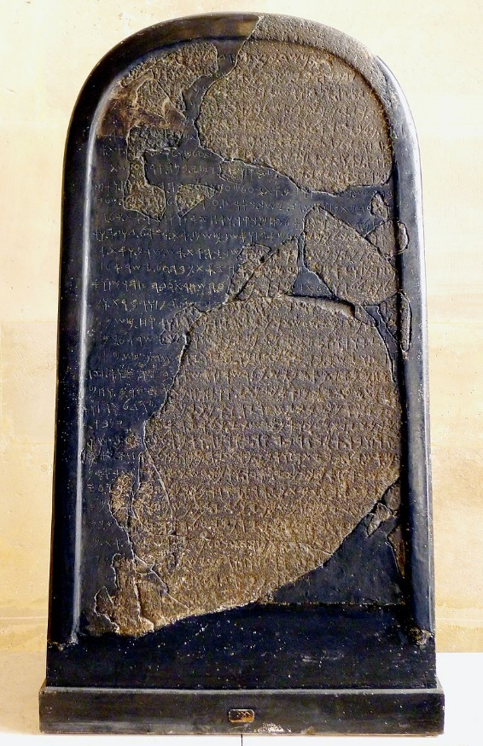

Slide 21
Elisha the Prophet
Follows Elijah
Inherits a double portion of his spirit
Prophesies for approximately 50 years

Slide 22
Elisha the Prophet
Heals the bad water
Curses the youth of Bethel
Ever-flowing oil
Poisoned stew neutralized
Feeds 100 with a mere 20 loaves
Naaman healed of leprosy

Slide 23
Elisha the Prophet
Axhead floats
Assists in the wars against Aram
Joram is likely the King of Israel
Samaria is seiged
Prophesies the death of Ben-Hadad
King of Aram
Also that Hazael will become King
Sends to have Jehu anointed King of Israel

Slide 24
The Line of David
Southern Kingdom of Judah
Capital City - Jerusalem
Jehoshaphat
Reigns 25 years
Becomes king at 35 years old
914-889 BC

Slide 25
The Line of David
Jehoram
Reigns 8 years (3 overlapping with Jehoshaphat)
Becomes king at 32 years old
892-885 BC
Ahaziah
Reigns 2 years
Becomes king at 22 years old
885-884 BC

Slide 26
Jehoshaphat’s Reign
Righteous King
Removed the high places and Asherah poles
Sent officials to teach the Law of Moses
Had peace in Judah
Allies with Ahab, King of Israel
Marries his son Jehoram to Athaliah
Ahaziah, their youngest son, born in 907 BC

Slide 27
Jehoshaphat’s Reign
Fight’s against Aram with Ahab
Battle at Ramoth Gilead
897 BC – Ahab killed
Builds trading ships with Ahaziah
Fleet built at Ezion Geber
Destroyed and unable to trade
Marches against Moab with Joram
Elisha prophesies water will come

Slide 28
Jehoshaphat’s Reign
Attacked by Moab, Ammon and Meunites
Seeks the Lord
Armies fight against each other
Destroyed each other
Judah merely collected the plunder

Slide 29
Jehoram’s Reign
Married to Athaliah
Walks in the ways of Ahab
Murders his 6 brothers
Rebuilds the high places
Edom rebels against Judah successfully
Rebuked by Elijah the prophet
Philistines and Arabs attack Judah
Carry off plunder, his wives and most of his sons
Dies of a lingering disease of the bowels

Slide 30
Ahaziah’s Reign
Walked in the ways of Ahab
Allied with Joram, King of Israel
Fought against Hazael, King of Aram, at Ramoth Gilead

Slide 31
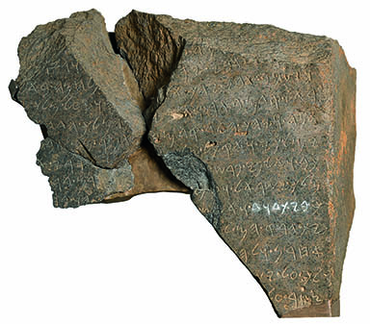

Slide 32
Jehu’s Zeal
Jehu, son of Jehshaphat, son of Nimshi
Kills Joram King of Israel
Kills Ahaziah King of Judah
Destroys the House of Ahab
Fulfills Elijah’s prophecy

