Slide 1
Matthew 15:18
¹⁸ But what comes out of the mouth proceeds from the heart, and this defiles a person.

Slide 2
Matthew 6:22-23
²² “The eye is the lamp of the body. So, if your eye is healthy, your whole body will be full of light, ²³ but if your eye is bad, your whole body will be full of darkness. If then the light in you is darkness, how great is the darkness!

Slide 3
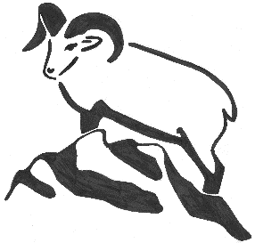
Foundations For Faith

Slide 4
New Testament Survey
Inter-Testamental Era
Life of Jesus
Acts of the Apostles
Church History

Slide 5
The Life of Jesus
Jesus’ 2nd Year of Ministry – Jan 14th
Jesus’ 3rd Year of Ministry – Jan 21st
Crucifixion Week – Jan 28th
Resurrection to Ascension – Feb 4th
Superbowl Sunday – Feb 11th

Slide 6
Books of the New Testament
Matthew
Mark
Luke
John
Acts
Romans
I Corinthians
II Corinthians
Galatians
Ephesians
Philippians
Colossians
I Thessalonians
II Thessalonians
I Timothy
II Timothy
Titus
Philemon
Hebrews
James
I Peter
II Peter
I John
II John
III John
Jude
Revelation

Slide 7
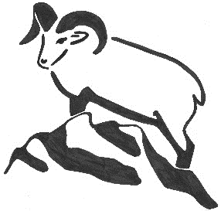
Crucifixion Week

Slide 8
Sunday, March 29th, 33 AD
Triumphal Entry into Jerusalem
Borrows a colt
Crowds yell “Hosanna”
Pharisees complain
Weeps over Jerusalem
Foretells the siege of Jerusalem

Slide 9
Sunday, March 29th, 33 AD
Cleanses the Temple
Drives out the moneychangers
Heals blind and lame in the temple
Returns to Bethany for the night

Slide 10
Monday, March 30th, 33 AD
Jesus curses a fig tree en route to the temple
Clears moneychangers out of the temple
Teaches in the Temple
Leaves Jerusalem

Slide 11
Tuesday, March 31st, 33 AD
Find the Withered Fig tree
Chief Priests & elders question his authority to teach and heal
Jesus asks them about John the Baptist’s authority
Three Parables
Parable of the Two Sons
Parable of the Tenants
Parable of the Wedding Feast

Slide 12
Tuesday, March 31st, 33 AD
Three Tests
Pharisees – Paying Taxes to Caesar
Sadducees – Marriage at the Resurrection
Lawyer – Which is the Greatest Commandment
Jesus Question
Whose son is the Christ?
7 Woes to the Scribes and Pharisees

Slide 13
Tuesday, March 31st, 33 AD
Leaves the Temple
Disciples remark on the splendor of the temple
Mentions every stone will be torn down
At the Mount of Olives with Disciples
Signs of the End of the Age
Parable of the 10 Virgins
Parable of the Talents
Parable of the Sheep and the Goats

Slide 14
Wednesday, April 1st, 33 AD
Pharisees plot to kill Jesus
Jesus anointed in Bethany (again??)
Dinner at Simon the Leper’s house
Woman pours jar of nard on his feet
Disciples scold her for it
Judas Iscariot agrees to betray Jesus
Given 30 pieces of silver

Slide 15
Thursday, April 2nd, 33 AD
Peter and John sent into Jerusalem to prepare the Passover Meal
Last Supper – After sunset
Institutes the Lord’s Supper
Satan enters Judas and he leaves to betray Jesus
Argue over who is the Greatest
Peter’s denial of Jesus foretold
Promises to send the Holy Spirit

Slide 16
Thursday, April 2nd, 33 AD
Walking to Gethsemane
Jesus is the True Vine
Warns them that the World will hate them
Describes the Ministry of the Holy Spirit
Jesus Prays for them
In Gethsemane
Jesus prays while disciples fall asleep

Slide 17
Thursday, April 2nd, 33 AD
Judas arrives and betrays Jesus
Peter draws a sword and cuts off Malchus’s ear
Jesus puts his ear back on
Jesus is arrested; disciples flee (except Peter and John)
Jesus taken to house of Caiaphas
John gets Peter into the courtyard
Jesus is tried by the Sanhedrin
Peter denies Jesus 3 times

Slide 18
Friday, April 3rd, 33 AD
Jesus taken to Pilate early in the morning
Pilate sends Jesus to Herod
Herod sends Jesus back to Pilate
Pilate releases Barabbas and condemns Jesus
Jesus crucified with 2 thieves
Judas returns the silver and hangs himself

Slide 19
Friday, April 3rd, 33 AD
Jesus dies
Darkness covers the land
Temple curtain is torn in two
Buried by Joseph of Arimathea
Member of the Sanhedrin
Puts Jesus into an unused tomb cut into stone
As the day ended and the Sabbath began

Slide 20
Saturday, April 4th, 33 AD
The women rested in obedience to the command

Slide 21
Major Signs of Crucifixion Week
Heals Blind and Lame
Curses the Fig Tree
Words of Wisdom
Prophesies the End of the Age
Predicts Peter’s Denial
Heals Malchus’s ear

