Slide 1
Micah 6:8
He has told you, O man, what is good;
and what does the Lord require of you
but to do justice, and to love kindness,
and to walk humbly with your God?

Slide 2
Joel 2:28-29
²⁸ “And it shall come to pass afterward,
that I will pour out my Spirit on all flesh;
your sons and your daughters shall prophesy,
your old men shall dream dreams,
and your young men shall see visions.
²⁹ Even on the male and female servants
in those days I will pour out my Spirit.

Slide 3
Foundations For Faith
Jotham, Ahaz & Hezekiah

Slide 4
Eras of the Old Testament
Beginnings Era
Patriarchs Era
Exodus Era
Conquest Era
Judges Era
United Monarchy
Divided Monarchy
Exile
The Return

Slide 5
Books of the Old Testament
Genesis
Exodus
Leviticus
Numbers
Deuteronomy
Joshua
Judges
Ruth
I&II Samuel
I&II Kings
I&II Chronicles
Ezra
Nehemiah
Esther
Job
Psalms
Proverbs
Ecclesiastes
Song of Songs
Isaiah
Jeremiah
Lamentations
Ezekiel
Daniel
Hosea
Joel
Amos
Obadiah
Jonah
Micah
Nahum
Habbakkuk
Zephaniah
Haggai
Zechariah
Malachi

Slide 6
Divided Monarchy Era
Jotham, Ahaz & Hezekiah – Mar 26th
Manasseh, Amon, Josiah – Apr 2nd
Easter Sunday – Apr 9th
The Fall of Jerusalem - Apr 16th
The Exile – Apr 23rd
Ezra & Nehemiah – Apr 30th

Slide 7
Jotham, Ahaz & Hezekiah

Slide 8
The Line of David
Southern Kingdom of Judah
Capital City - Jerusalem
Jotham
  Reigns 16 years
  Becomes king at 25 years old
  759-742 BC

Slide 9
The Line of David
Ahaz
  Reigns 16 years
  Becomes king at 20 years old
  742-726 BC
Hezekiah
  Reigns 29 years
  Becomes king at 25 years old
  726-698 BC

Slide 10
Reign of Jotham
Righteous King
  Did not enter the temple like Uzziah
  High places were not removed
  People continued corrupt practices
Subjugated the Ammonites
Judah pressured by
  Rezin of Aram
  Pekah of Israel

Slide 11
Reign of Ahaz
Most wicked king of Judah to date
  Walks in the ways of the Kings of Israel – Baal worship
  Practiced child sacrifice in the Valley of Ben Hinnom
  Burned incense at the high places, hilltops and under every spreading tree.
Judah handed over to Israel & Aram

Slide 12
Reign of Ahaz
Defeated by Pekah, son of Remaliah
  120,000 soldiers of Judah slain
  200,000 captives taken to Samaria with plunder
  Captives returned after Oded prophesied
Edomites attack Judah
Philistines attack Judah

Slide 13
Reign of Ahaz
Send to Tiglath Pileser of Assyria for help
  Emptied the treasury of the palace and temple
  Assyria destroys Aram
  Deports Arameans
  Takes Eastern tribal areas from Israel
Ahaz meets Tiglath Pileser in Damascus
  Sends drawings of an altar back to Jerusalem
  Returns and sacrifices on it.
  Remodels the temple

Slide 14
Reign of Hezekiah
Most righteous king since David
Removes high places
Smashes sacred stones
Cuts down Asherah poles
Broke up the Bronze snake
Repairs and purifies the temple

Slide 15
Celebrates Passover
14th day of the 2nd month
  Not enough priests were consecrated
Invites Ephraim & Manasseh
  Just before the Siege of Samaria by Assyrians
Celebrate an extra 7 days

Slide 16
Attacked by Sennacherib
713-711 BC
Lays siege to fortified cities of Judah
  Most famously Lachish

Slide 17
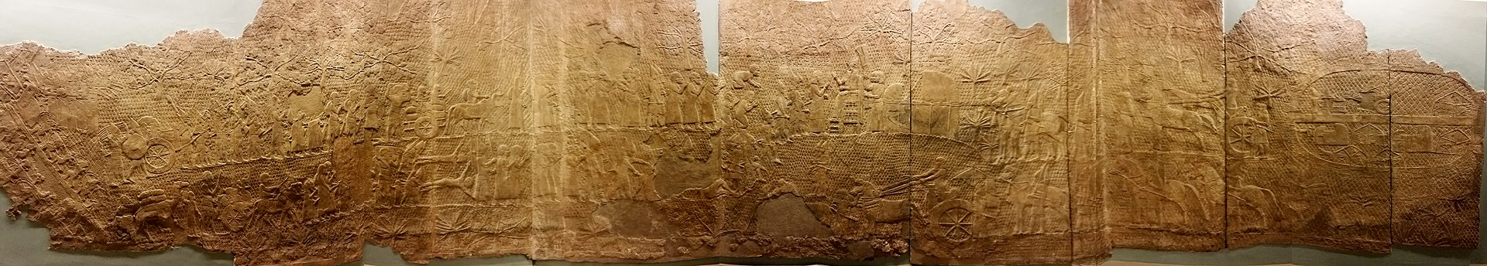
Siege of Lachish

Slide 18
Siege of Lachish

Slide 19
Sennacherib and Jerusalem
Hezekiah diverts the water
Sends the Rabshakeh with a threat
Sends a threatening letter
Isaiah prophesies Assyria's defeat
Angel of the Lord destroys 185,000 soldiers in the camp of Assyria

Slide 20
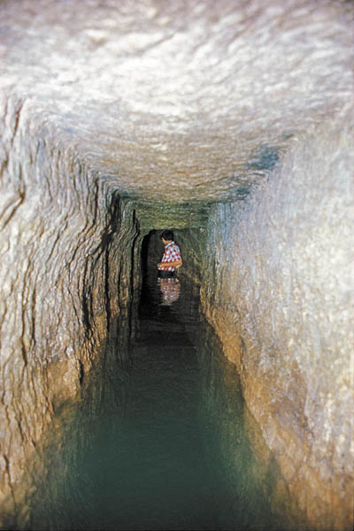

Slide 21
Hezekiah’s Illness
During this time he gets sick
Isaiah tells him he is going to die
  Hezekiah cries out to God
  Isaiah returns with a sign for healing – 15 more years
Shadow goes backwards
Babylonians notice and send envoys
Hezekiah becomes proud

Slide 22
Isaiah
Longest Prophet, 2nd longest OT Book
Prophesies during the reigns of Uzziah, Jotham, Ahaz and Hezekiah
  Approximately 65 years
Killed early in Manasseh’s reign
  Hebrews 11:37a
  “They were stoned, they were sawn in two, they were killed with the sword.”

Slide 23
Oversimplified Outline
Chapters 1-35 – Judgement & Destruction
Chapters 36-39 – Hezekiah’s Reign
Chapters 40-66 – Comfort & Restoration

Slide 24
Highlights of Isaiah
Vision of God’s Throne – Isa. 6
Prophesies demise of Aram and Israel – Isa. 7
  And the virgin birth of Jesus
Prophecies deliverance of Jerusalem – Isa. 37
  When Sennacherib attacks Hezekiah
Prophecies Rebuilding Jerusalem – Isa. 44-45
  Names Cyrus the Persian King who commands it.

Slide 25
Highlights of Isaiah
Describes the Death of Jesus – Isa. 52-53
Prophesies the New Heaven and Earth – Isa. 65-66

Slide 26
Micah
Prophesies during reigns of Jotham, Ahaz & Hezekiah
7 Chapters
References in Jeremiah 26:18

Slide 27
Highlights of Micah
Millennial Prophecy – Micah 4
Bethlehem identified – Micah 5
  Birthplace of Jesus referenced in Matthew 2

Slide 28
Mountaintop Prophecy
Interpreting Biblical Prophecy

Slide 29
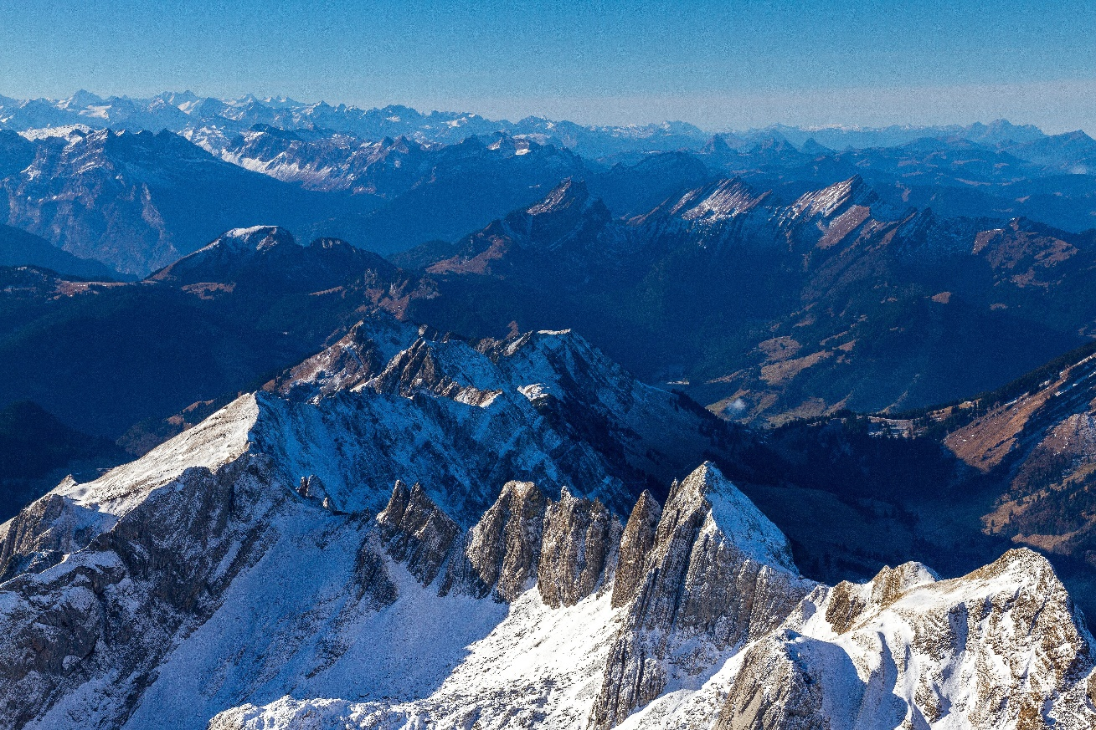

Slide 30
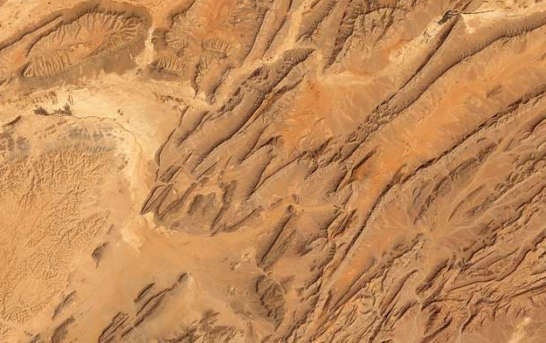

Slide 31
Daniel 11:2
² “And now I will show you the truth. Behold, three more kings shall arise in Persia, and a fourth shall be far richer than all of them. And when he has become strong through his riches, he shall stir up all against the kingdom of Greece.

Slide 32
Xerxes I
Rules Persian Empire 485-465 BC
480 BC launches invasion of Greece
  Large army drawn from across his Empire
  Defeated in the naval battle at Salamis 480 BC
  Defeated on land in the battle of Platea 479 BC

Slide 33
Daniel 11:3-4
³ Then a mighty king shall arise, who shall rule with great dominion and do as he wills. ⁴ And as soon as he has arisen, his kingdom shall be broken and divided toward the four winds of heaven, but not to his posterity, nor according to the authority with which he ruled, for his kingdom shall be plucked up and go to others besides these.

Slide 34
Alexander the Great
Rules 336-323 BC
  Destroys Persian Empire in 330 BC
  Kingdom split 4 ways after his death
  Egypt, Syria, Pergamum, Macedonia

Slide 35
Daniel 11:2b-3
And when he has become strong through his riches, he shall stir up all against the kingdom of Greece. ³ Then a mighty king shall arise, who shall rule with great dominion and do as he wills.

Slide 36
Prophetic Valley
Artaxerxes I 465-424 BC
Darius II 424-404 BC
Artaxerxes II 404-358 BC
Artaxerxes III 358-338 BC
Artaxerxes IV 338-336 BC
Darius III 336-330 BC

Slide 37
Isaiah 65:17
¹⁷ “For behold, I create new heavens
and a new earth,
and the former things shall not be remembered
or come into mind.

Slide 38
Isaiah 65:18
¹⁸ But be glad and rejoice forever
in that which I create;
for behold, I create Jerusalem to be a joy,
and her people to be a gladness.

Slide 39
Isaiah 65:19
¹⁹ I will rejoice in Jerusalem
and be glad in my people;
no more shall be heard in it the sound of weeping
and the cry of distress.

Slide 40
Isaiah 65:20
²⁰ No more shall there be in it
an infant who lives but a few days,
or an old man who does not fill out his days,
for the young man shall die a hundred years old,
and the sinner a hundred years old shall be accursed.

Slide 41
Isaiah 65:21-22
²¹ They shall build houses and inhabit them;
they shall plant vineyards and eat their fruit.
²² They shall not build and another inhabit;
they shall not plant and another eat;
for like the days of a tree shall the days of my people be,
and my chosen shall long enjoy the work of their hands.

