Slide 1
Revelation 12:11
¹¹ And they have conquered him by the blood of the Lamb and by the word of their testimony, for they loved not their lives even unto death.

Slide 2
Revelation 13:2
² And the beast that I saw was like a leopard; its feet were like a bear's, and its mouth was like a lion's mouth. And to it the dragon gave his power and his throne and great authority.

Slide 3
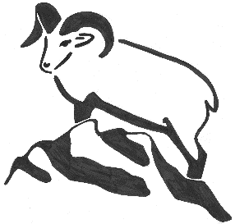
Foundations For Faith

Slide 4
New Testament Survey
Inter-Testamental Era
Life of Jesus
Acts of the Apostles
Church History

Slide 5
The Acts of the Apostles
General Epistles – Apr 21st
Revelation – Apr 28th
Church History – May 5th
May 12th – Mother’s Day
May 19th – Graduation Day

Slide 6
Books of the New Testament
Matthew
Mark
Luke
John
Acts
Romans
I Corinthians
II Corinthians
Galatians
Ephesians
Philippians
Colossians
I Thessalonians
II Thessalonians
I Timothy
II Timothy
Titus
Philemon
Hebrews
James
I Peter
II Peter
I John
II John
III John
Jude
Revelation

Slide 7
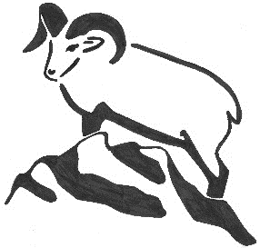
The General Epistles

Slide 8
Book of Hebrews
Author Unknown
Acquaintance of Timothy
Probably a Jew
Tertullian ascribed it to Barnabas
Written to the Hebrews
Supremacy and Sufficiency of Christ
Our Great High Priest
Sacrificed Once and For All

Slide 9
Book of Hebrews
Old Covenant shadow of the New Covenant
Sabbath
Priesthood
Tabernacle
Sacrifices
Hall of Faith – Chapter 11
Old Testament examples of faith

Slide 10
Book of James
Written by James the Brother of Jesus
Leader in the Church of Jerusalem
Probably written 40-50 AD
Written to the 12 tribes in the Dispersion
Themes
Trials and Perseverance
Faith and Works
Taming the Tongue

Slide 11
Book of I Peter
Written by Peter, the Apostle
Written to the elect exiles of the Dispersion
Pontus, Galatia, Cappadocia, Asia & Bithynia
Themes
Christian Living
Wives & Husbands
Suffering

Slide 12
Book of II Peter
Written by Peter, the Apostle
Written to believers
Recounts the Transfiguration
Themes
Addresses False Teachers and teachings
The Day of the Lord

Slide 13
II Peter 3:15-16
¹⁵ And count the patience of our Lord as salvation, just as our beloved brother Paul also wrote to you according to the wisdom given him, ¹⁶ as he does in all his letters when he speaks in them of these matters. There are some things in them that are hard to understand, which the ignorant and unstable twist to their own destruction, as they do the other Scriptures.

Slide 14
Book of I John
Written by John, the Apostle
Written to a general audience
Themes
Love One Another
Do not Love the World

Slide 15
Book of II John
Written by John, the Apostle
Written to the elect lady and her children
Themes
False teachers denying the physical coming of Jesus

Slide 16
Book of III John
Written by John, the Apostle
Written to Gaius, his friend
Themes
Showing hospitality to itinerant ministers
Condemning Diotrephes
Commending Demetrius

Slide 17
Book of Jude
Written by Jude, the brother of James
Written to a general audience
Themes
Perverters of the Grace of God

