Slide 1
Walking by Faith

Slide 2
Facets of New Vision
Strengthen Congregation Connections
Serve the Community
Minister to the Youth
Energize the Service
Show Signs of Life
De-Scary the Basement

Slide 3
II Kings 13:14-15
¹⁴ Now when Elisha had fallen sick with the illness of which he was to die, Joash king of Israel went down to him and wept before him, crying, “My father, my father! The chariots of Israel and its horsemen!” ¹⁵ And Elisha said to him, “Take a bow and arrows.” So he took a bow and arrows.

Slide 4
II Kings 13:16-17
¹⁶ Then he said to the king of Israel, “Draw the bow,” and he drew it. And Elisha laid his hands on the king's hands. ¹⁷ And he said, “Open the window eastward,” and he opened it. Then Elisha said, “Shoot,” and he shot. And he said, “The Lord's arrow of victory, the arrow of victory over Syria! For you shall fight the Syrians in Aphek until you have made an end of them.”

Slide 5
II Kings 13:18-19
¹⁸ And he said, “Take the arrows,” and he took them. And he said to the king of Israel, “Strike the ground with them.” And he struck three times and stopped. ¹⁹ Then the man of God was angry with him and said, “You should have struck five or six times; then you would have struck down Syria until you had made an end of it, but now you will strike down Syria only three times.”

Slide 6
II Kings 13:24-25
²⁴ When Hazael king of Syria died, Ben-hadad his son became king in his place. ²⁵ Then Jehoash the son of Jehoahaz took again from Ben-hadad the son of Hazael the cities that he had taken from Jehoahaz his father in war. Three times Joash defeated him and recovered the cities of Israel.

Slide 7
Facets of New Vision
Strengthen Congregation Connections
Serve the Community
Minister to the Youth
Energize the Service
Show Signs of Life
De-Scary the Basement

Slide 8
Genesis 11:1
Now the Lord said to Abram, “Go from your country and your kindred and your father's house to the land that I will show you.

Slide 9
Genesis 11:4-5a
⁴ So Abram went, as the Lord had told him, and Lot went with him. Abram was seventy-five years old when he departed from Haran. ⁵ And Abram took Sarai his wife, and Lot his brother's son, and all their possessions that they had gathered, and the people that they had acquired in Haran, and they set out to go to the land of Canaan.

Slide 10
Hebrews 11:8
⁸ By faith Abraham obeyed when he was called to go out to a place that he was to receive as an inheritance. And he went out, not knowing where he was going.

Slide 11
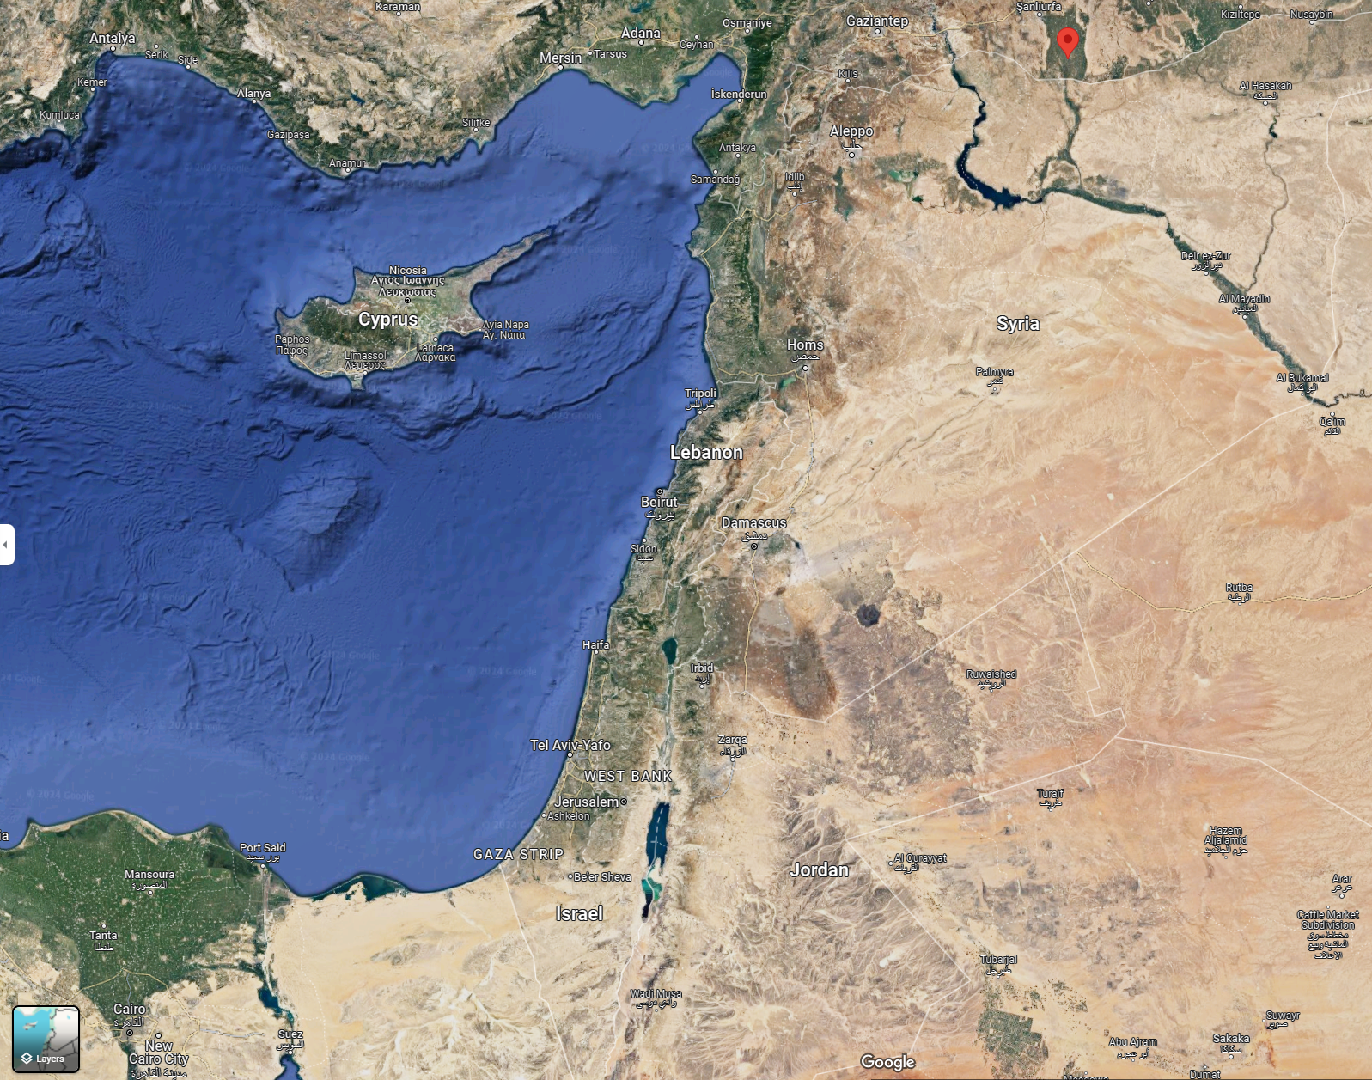
Abram’s Journey
Departs Haran
Destination Unknown

Slide 12
Genesis 11:31-32
³¹ Terah took Abram his son and Lot the son of Haran, his grandson, and Sarai his daughter-in-law, his son Abram's wife, and they went forth together from Ur of the Chaldeans to go into the land of Canaan, but when they came to Haran, they settled there. ³² The days of Terah were 205 years, and Terah died in Haran.

Slide 13
Terah’s Journey

Slide 14
Genesis 12:5b-7
When they came to the land of Canaan, ⁶ Abram passed through the land to the place at Shechem, to the oak of Moreh. At that time the Canaanites were in the land. ⁷ Then the Lord appeared to Abram and said, “To your offspring I will give this land.” So he built there an altar to the Lord, who had appeared to him.

Slide 15
Facets of New Vision
Strengthen Congregation Connections
Serve the Community
Minister to the Youth
Energize the Service
Show Signs of Life
De-Scary the Basement

Slide 17
Welcome to

