Slide 1
Christ is the Head of the Church

Slide 2
Proverbs 22:28
²⁸ Do not move an ancient boundary stone set up by your ancestors.

Slide 4
Japanese Tsunami, 2011

Slide 5
Ephesians 1:22-23
²² And God placed all things under his feet and appointed him to be head over everything for the church, ²³ which is his body, the fullness of him who fills everything in every way.

Slide 6
Ephesians 5:23-24a
²³ For the husband is the head of the wife as Christ is the head of the church, his body, of which he is the Savior. ²⁴ Now as the church submits to Christ…

Slide 7
Ephesians 2:19-20
¹⁹ Consequently, you are no longer foreigners and strangers, but fellow citizens with God’s people and also members of his household, ²⁰ built on the foundation of the apostles and prophets, with Christ Jesus himself as the chief cornerstone.

Slide 8
Ephesians 2:21-22
²¹ In him the whole building is joined together and rises to become a holy temple in the Lord. ²² And in him you too are being built together to become a dwelling in which God lives by his Spirit.

Slide 9
I Peter 5:1-3
To the elders among you, I appeal as a fellow elder and a witness of Christ’s sufferings who also will share in the glory to be revealed: ² Be shepherds of God’s flock that is under your care, watching over them—not because you must, but because you are willing, as God wants you to be; not pursuing dishonest gain, but eager to serve; ³ not lording it over those entrusted to you, but being examples to the flock.

Slide 10
I Peter 5:4-5
⁴ And when the Chief Shepherd appears, you will receive the crown of glory that will never fade away.
⁵ In the same way, you who are younger, submit yourselves to your elders. All of you, clothe yourselves with humility toward one another, because,
“God opposes the proud but shows favor to the humble.”

Slide 11
Acts 20:28
²⁸ Keep watch over yourselves and all the flock of which the Holy Spirit has made you overseers. Be shepherds of the church of God, which he bought with his own blood.

Slide 12
Exodus 13:21-22
²¹ By day the Lord went ahead of them in a pillar of cloud to guide them on their way and by night in a pillar of fire to give them light, so that they could travel by day or night. ²² Neither the pillar of cloud by day nor the pillar of fire by night left its place in front of the people.

Slide 13
Exodus 14:11
¹¹ They said to Moses, “Was it because there were no graves in Egypt that you brought us to the desert to die? What have you done to us by bringing us out of Egypt?

Slide 14
Exodus 16:2-3
² In the desert the whole community grumbled against Moses and Aaron. ³ The Israelites said to them, “If only we had died by the Lord’s hand in Egypt! There we sat around pots of meat and ate all the food we wanted, but you have brought us out into this desert to starve this entire assembly to death.”

Slide 15
Exodus 16:6-7
⁶ So Moses and Aaron said to all the Israelites, “In the evening you will know that it was the Lord who brought you out of Egypt, ⁷ and in the morning you will see the glory of the Lord, because he has heard your grumbling against him. Who are we, that you should grumble against us?”

Slide 16
Exodus 17:3
³ But the people were thirsty for water there, and they grumbled against Moses. They said, “Why did you bring us up out of Egypt to make us and our children and livestock die of thirst?”

Slide 17
I Samuel 8:4-5
⁴ So all the elders of Israel gathered together and came to Samuel at Ramah. ⁵ They said to him, “You are old, and your sons do not follow your ways; now appoint a king to lead us, such as all the other nations have.”

Slide 18
I Samuel 8:6-7
⁶ But when they said, “Give us a king to lead us,” this displeased Samuel; so he prayed to the Lord. ⁷ And the Lord told him: “Listen to all that the people are saying to you; it is not you they have rejected, but they have rejected me as their king.

Slide 19
Ephesians 5:23
²³ For the husband is the head of the wife as Christ is the head of the church, his body, of which he is the Savior.

Slide 20
Ignatius of Antioch
Disciple of John the Apostle
Wrote of Bishops/Overseers like they are the head of the church

Slide 21
Letter to Church in Magnesia
Take care to do all things in harmony with God, with the bishop presiding in the place of God, and with the presbyters in the place of the council of the apostles, and with the deacons…

Slide 22
Letter to Church in Smyrna
It is not lawful to baptize or give communion without the consent of the bishop. On the other hand, whatever has his approval is pleasing to God. Thus, whatever is done will be safe and valid.

Slide 23
Acts 8:4-5
⁴ Those who had been scattered preached the word wherever they went. ⁵ Philip went down to a city in Samaria and proclaimed the Messiah there. ⁶ When the crowds heard Philip and saw the signs he performed, they all paid close attention to what he said.

Slide 24
Acts 8:12-13
¹² But when they believed Philip as he proclaimed the good news of the kingdom of God and the name of Jesus Christ, they were baptized, both men and women. ¹³ Simon himself believed and was baptized. And he followed Philip everywhere, astonished by the great signs and miracles he saw.

Slide 25
Ephesians 5:23
²³ For the husband is the head of the wife as Christ is the head of the church, his body, of which he is the Savior.

Slide 26
Glenn Ewing, his wife, their son Robert Ewing

Slide 27
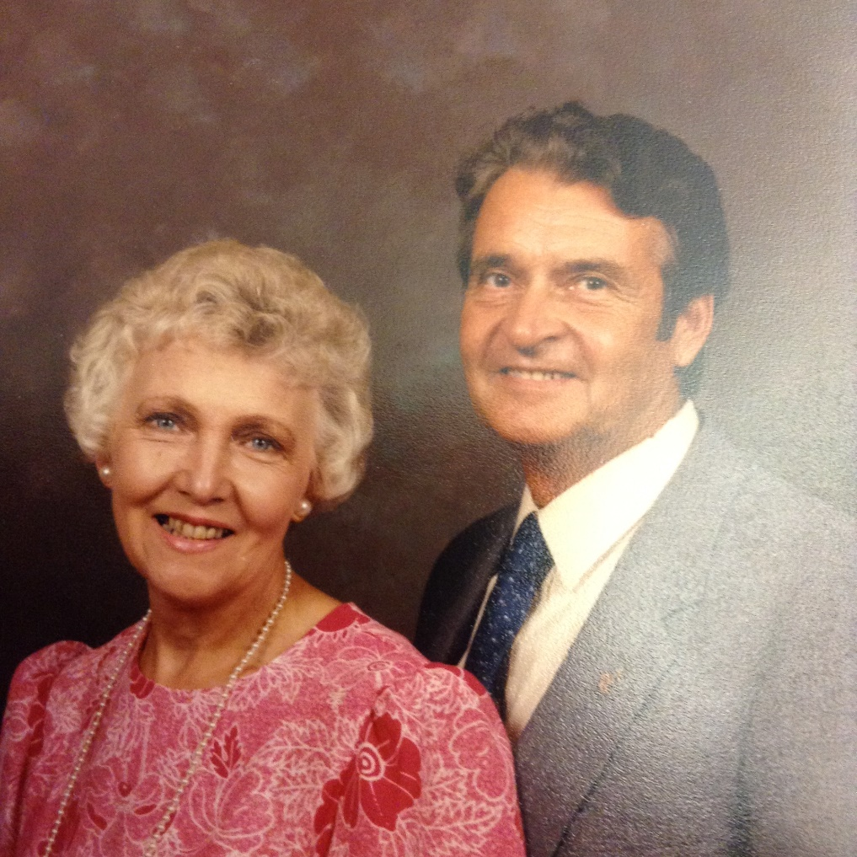
Fred Herzog Clarence & Maxine

Slide 29
Proverbs 22:28
²⁸ Do not move an ancient boundary stone set up by your ancestors.

Slide 31
Welcome to

